Slide 1
PROBLEMS ON AGES

Slide 2
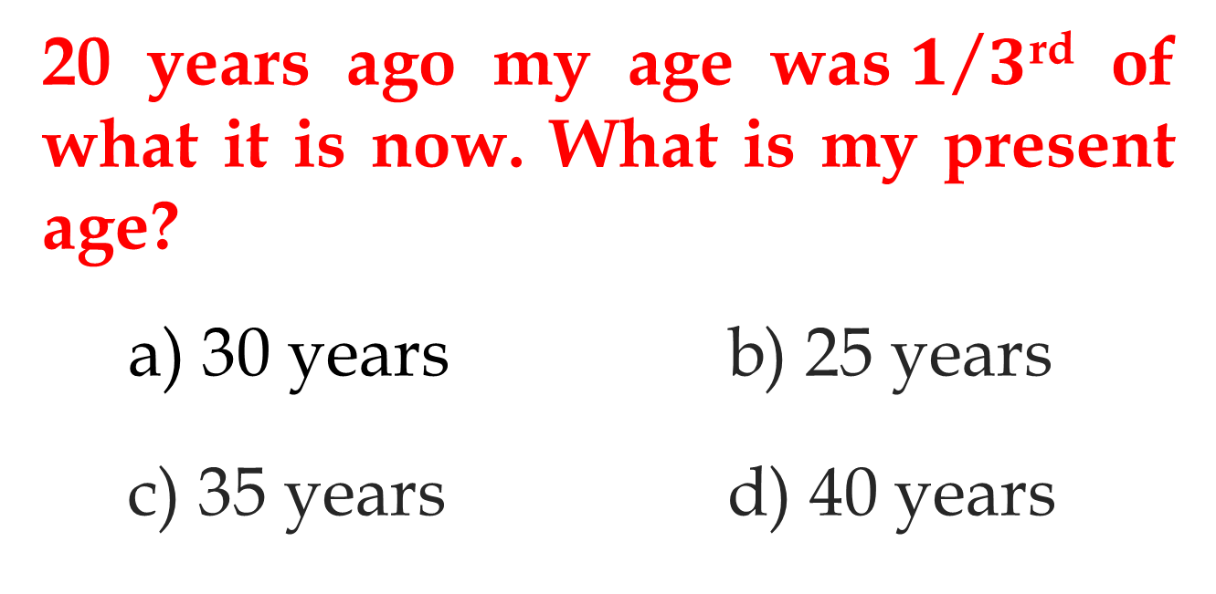
Question - 1
20 years ago my age was$1/3$^{rd} of what it is now. What is my present age?
a) 30 years b) 25 years
c) 35 years d) 40 years

Slide 3
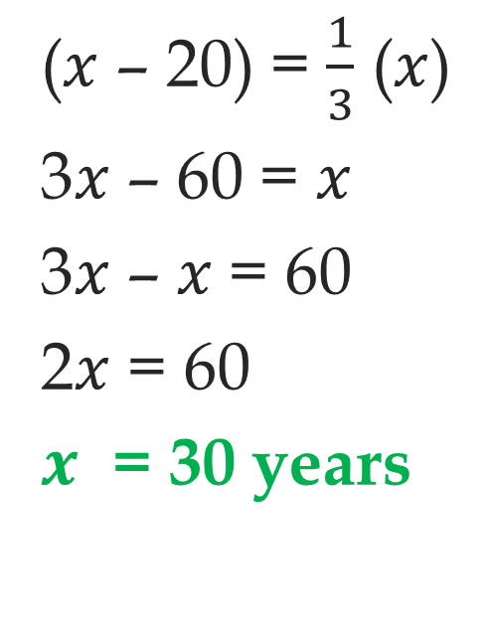
Solution
($x$ – 20) = $\frac{1}{3}$ ($x$)
3$x$ – 60 = $x$
3$x$ – $x$= 60
2$x$ = 60
$x$ = 30 years

Slide 4
Question - 2
The present age of the father is 5 times that of his son. The age of the father 3 years ago was 8 times the age of his son. What is the present age of the son?
a) 35 years b) 9 years
c) 7 years d) 25 years

Slide 5
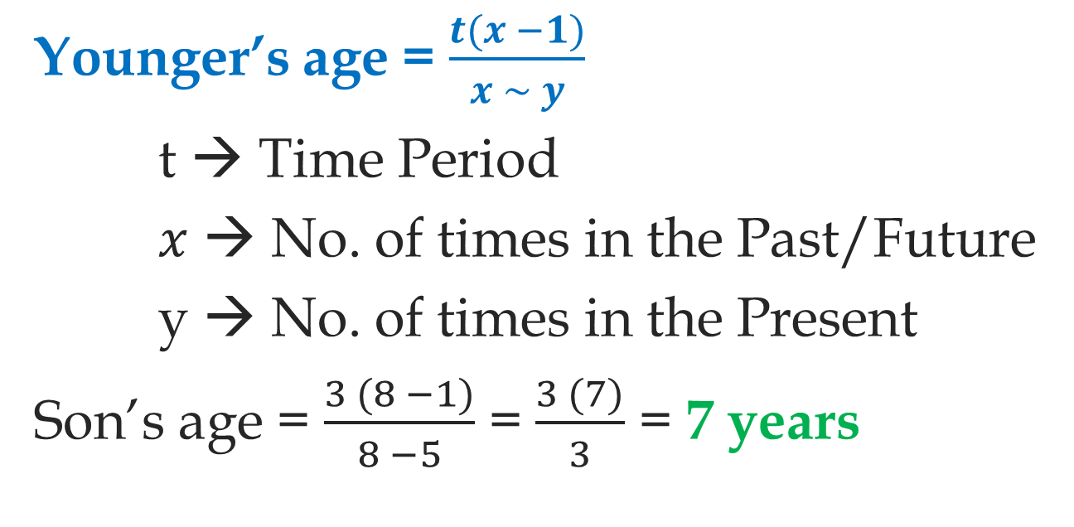
Solution
Younger’s age = $\frac{t(x −1)}{x \sim y}$
t → Time Period
$x$ → No. of times in the Past/Future
y → No. of times in the Present
Son’s age = $\frac{3 (8 −1)}{8 −5}$ = $\frac{3 (7)}{3}$ = 7 years

Slide 6
Question - 3
Sachin’s present age is 3 times that of his son Arjun. In 12 years, Sachin’s age will be double the Arjun’s age. Find the present age of Sachin.
a) 12 years b) 32 years
c) 36 years d) 40 years

Slide 7
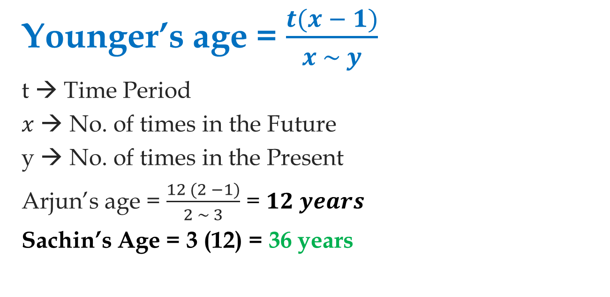
Younger’s age = $\frac{t(x − 1)}{x \sim y}$
t → Time Period
$x$ → No. of times in the Future
y → No. of times in the Present
Arjun’s age = $\frac{12 (2 −1)}{2 \sim 3}$ = $12 years$
Sachin’s Age = 3 (12) = 36 years

Slide 8
Question - 4
The ratio of the ages Father and Son is 5 : 3 and the sum of their ages is 64 years. What will be ratio of their ages after 16 years?
a) 7 : 5 b) 7 : 9
c) 23 : 11 d) 19 : 23

Slide 9
Question - 4
The ratio of the ages Father and Son is 5 : 3 and the sum of their ages is 64 years. What will be ratio of their ages after 16 years?
a) 7 : 5 b) 7 : 9
c) 23 : 11 d) 19 : 23

Slide 10
Question - 5
Present ages of Johny and his Mother are in the ratio of 5 : 9 respectively. After 8 years the ratio of their ages will be 7 : 11 respectively. What was mother’s age five years ago?
a) 36 years b) 25 years c) 31 years d) 41 years

Slide 11
Question - 5
Present ages of Johny and his Mother are in the ratio of 5 : 9 respectively. After 8 years the ratio of their ages will be 7 : 11 respectively. What was mother’s age five years ago?
a) 36 years b) 25 years c) 31 years d) 41 years

Slide 12
Question - 6
The ratio of the present ages of Swetha and her father is 7 : 13. However, six years ago, the ratio of their ages was 5 : 11, then the difference between their ages five years ago was?
a) 13 years b) 23 years
c) 18 years d) 8 years

Slide 13
Question - 6
The ratio of the present ages of Swetha and her father is 7 : 13. However, six years ago, the ratio of their ages was 5 : 11, then the difference between their ages five years ago was?
a) 13 years b) 23 years
c) 18 years d) 8 years

Slide 14
Question - 7
Six years ago, the ratio of the ages of Saina and Sindhu was 6 : 5. Four years hence, the ratio of their ages will be 11 : 10. What is the age of Sindhu at present?
a) 16 years b) 18 years
c) 14 years d) 20 years

Slide 15
Question - 7
Six years ago, the ratio of the ages of Saina and Sindhu was 6 : 5. Four years hence, the ratio of their ages will be 11 : 10. What is the age of Sindhu at present?
a) 16 years b) 18 years
c) 14 years d) 20 years

Slide 16
Question - 8
The present age of Balakrishna and Prabhas are in the ratio of 4:5. After 5 years, the ratio of their ages will become 9:11. Find the sum of their present ages?
a) 94 years b) 78 years
c) 90 years d) 81 years

Slide 17
Question - 8
The present age of Balakrishna and Prabhas are in the ratio of 4:5. After 5 years, the ratio of their ages will become 9:11. Find the sum of their present ages?
a) 94 years b) 78 years
c) 90 years d) 81 years

Slide 18
Question - 9
5 years ago the age of the mother was 4 times the age of her daughter. 15 years hence, the age of the mother becomes 2 times the age of her daughter. What is the present age of the mother?
a) 45 years b) 40 years
c) 65 years d) 55 years

Slide 19
Question - 9
5 years ago the age of the mother was 4 times the age of her daughter. 15 years hence, the age of the mother becomes 2 times the age of her daughter. What is the present age of the mother?
a) 45 years b) 40 years
c) 65 years d) 55 years

Slide 20
Question - 10
The present ages of Akalya, Anusha and Asmitha are in the ratio 4 : 7 : 9. Eight years ago, the sum of their ages was 56. Find their present ages.
a) 8, 20, 28 years b) 16, 28, 36 years
c) 20, 35, 45 years d) 10, 17, 25 years

Slide 21
Question - 10
The present ages of Akalya, Anusha and Asmitha are in the ratio 4 : 7 : 9. Eight years ago, the sum of their ages was 56. Find their present ages.
a) 8, 20, 28 years b) 16, 28, 36 years
c) 20, 35, 45 years d) 10, 17, 25 years

Slide 22
Question - 11
Chiranjeevi is two years older than Nagarjun who is twice as old as Mahesh Babu. If the total of the ages of Chiranjeevi , Nagarjun and Mahesh Babu be 127, the how old is Nagarjun?
a) 50 years b) 25 years
c) 52 years d) 35 years

Slide 23
Question - 11
Chiranjeevi is two years older than Nagarjun who is twice as old as Mahesh Babu. If the total of the ages of Chiranjeevi , Nagarjun and Mahesh Babu be 127, the how old is Nagarjun?
a) 50 years b) 25 years
c) 52 years d) 35 years

Slide 24
Question - 12
The age of John today is twice that of his cousin. However, ten years hence, the age of his cousin will be four-seventh of that of him. What is present age of John?
a) 40 years b) 50 years c) 60 years d) 70 years

Slide 25
Question - 12
The age of John today is twice that of his cousin. However, ten years hence, the age of his cousin will be four-seventh of that of him. What is present age of John?
a) 40 years b) 50 years c) 60 years d) 70 years

Slide 26
Question - 13
Ramar’s age is 130% of what it was 4 years ago, but 90% of what it will be after 4 years. What is his present age?
a) 9 years b) 15 years
c) 12 years d) 22 years

Slide 27
Question - 13
Ramar’s age is 130% of what it was 4 years ago, but 90% of what it will be after 4 years. What is his present age?
a) 9 years b) 15 years
c) 12 years d) 22 years

Slide 28
Question - 14
Vijay said to his son that, “I was as old as you are at the present at the time of your birth”. If Vijay’s age is 48 years now, his son’s age five years back was:
a) 24 years b) 20 years c) 19 years d) 18 years

Slide 29
Question - 14
Vijay said to his son that, “I was as old as you are at the present at the time of your birth”. If Vijay’s age is 48 years now, his son’s age five years back was:
a) 24 years b) 20 years c) 19 years d) 18 years

Slide 30
Question - 15
If the ages of A and C are added to twice the age of B, the total becomes 59. If the ages of B and C are added to thrice the age of A, the total becomes 68. And if the age of A is added to the thrice the age of B and thrice the age of C, the total becomes 108. What is the age of A?
a) 15 years b) 19 years
c) 17 years d) 12 years

Slide 31
Question - 15
If the ages of A and C are added to twice the age of B, the total becomes 59. If the ages of B and C are added to thrice the age of A, the total becomes 68. And if the age of A is added to the thrice the age of B and thrice the age of C, the total becomes 108. What is the age of A?
a) 15 years b) 19 years
c) 17 years d) 12 years

Slide 32
CONCEPT CLARITY QUESTIONS

Slide 33
Question - 1
The ratio of the father’s age to the son’s age is 4 : 1. The product of their ages is 196. What will be the ratio of their ages after 5 years?
a) 32 : 12 b) 34 : 12
c) 11 : 4 d) 11 : 6

Slide 34
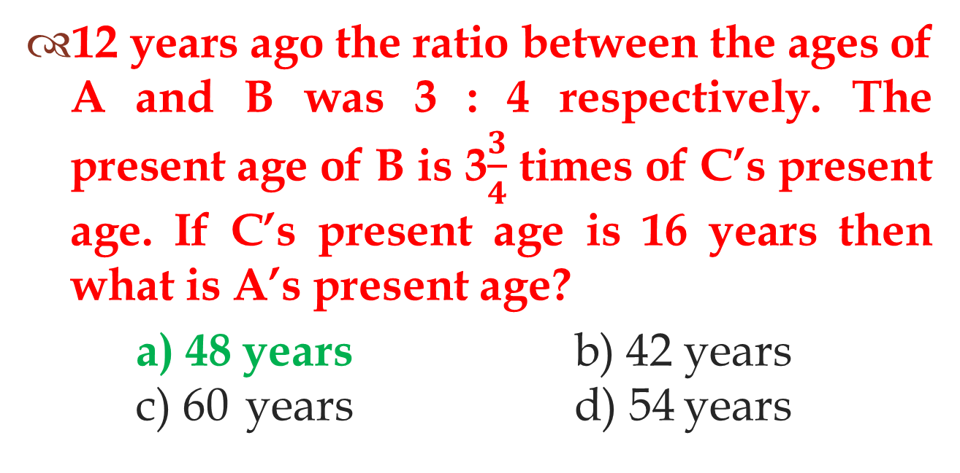
Question - 2
12 years ago the ratio between the ages of A and B was 3 : 4 respectively. The present age of B is 3$\frac{3}{4}$ times of C’s present age. If C’s present age is 16 years then what is A’s present age?
a) 48 years b) 42 years c) 60 years d) 54 years

Slide 35
Question - 3
The average age of a family of 5 members is 24 years. If the present age of the youngest member is 8 years, what was the average of the family at the time of the birth of the youngest member?
a)20 years b)16 years c)12 years d)18 years

Slide 36
Question - 4
Samantha is as much younger than Kaajal as she is older than Yashika. If the sum of Kaajal’s and Yashika’s ages is 40 years. Find the age of Samantha.
a) 20 years b) 25 years
c) 30 years d) 27 years

Slide 37
Question - 5
The age of the mother 4 years ago was 8 times the age of his daughter. At present the mother’s age is 4 times that of her daughter. Find the present age of daughter.
a) 9 years b) 7 years c) 14 years d) 18 years

Slide 38
Question - 6
5 years ago, the ratio of the ages of Kohli and Dhoni was 3:4. After 5 years, the ratio of their ages will be 4 : 5. Find Kohli 's present age?
a) 45 years b) 35 years
c) 30 years d) 40 years

Slide 39
Question - 7
A father said to his son, "I was as old as you are at the present at the time of your birth". If the father's age is 40 years now, find son’s present age?
a) 20 years b) 25 years c) 15 years d) 22 years

Slide 40
Question - 8
Three years before the average age of the family of 5 members was 17 years. Due to the birth of a new child, the average age is same today. Find the present age of the child.
a) 1 year b) 3 years c) 2.5 years d) 2 years

Slide 41
THANK YOU

